Slide 1

Kobo audio book

Slide 2

INDEX
Basic Overview
Functionalities
Technologies Used
Flow Of Application
GitHub
Challenges Faced
SonarQube Report

Slide 3
Basic overview
KOBO AUDIO BOOK APP
The KOBO Audio Book App has a very user-friendly interface. The vast digital collection of audio tracks can be navigated quickly, so there’s no need to spend time fruitlessly browsing unless you want to.
The key advantage of this app is that audio books contains tracks of variety of genre like motivation,horror,and fantasy. This is really helpful to hear audios customized by user preferences.

Slide 4

Functionalities
Search Functionality
Dynamic Home Page
Dynamic Audio Book Page
Dynamic Music Page
Favorites
Media Player
Login, Sign-up
User Dashboard
AUDIO BOOK APP
Notes:
All covered as per requirements.

Slide 5
Technologies used
Front-End
HTML
CSS
Bootstrap 5.0
RWD
Back-End
JS
Fetch
JSON-Server

Slide 6
Flow of application
Register
Login
Listen
Favorite
Logout

Slide 7
Challenges faced
Login - Finding username if it is already present or not.
Search – Preventing multiple search results having same tags and names.
Integration – Integration of JSON data and UI.
Favorite – Managing favorites of a particular user.
KOBO Audio Book

Slide 8
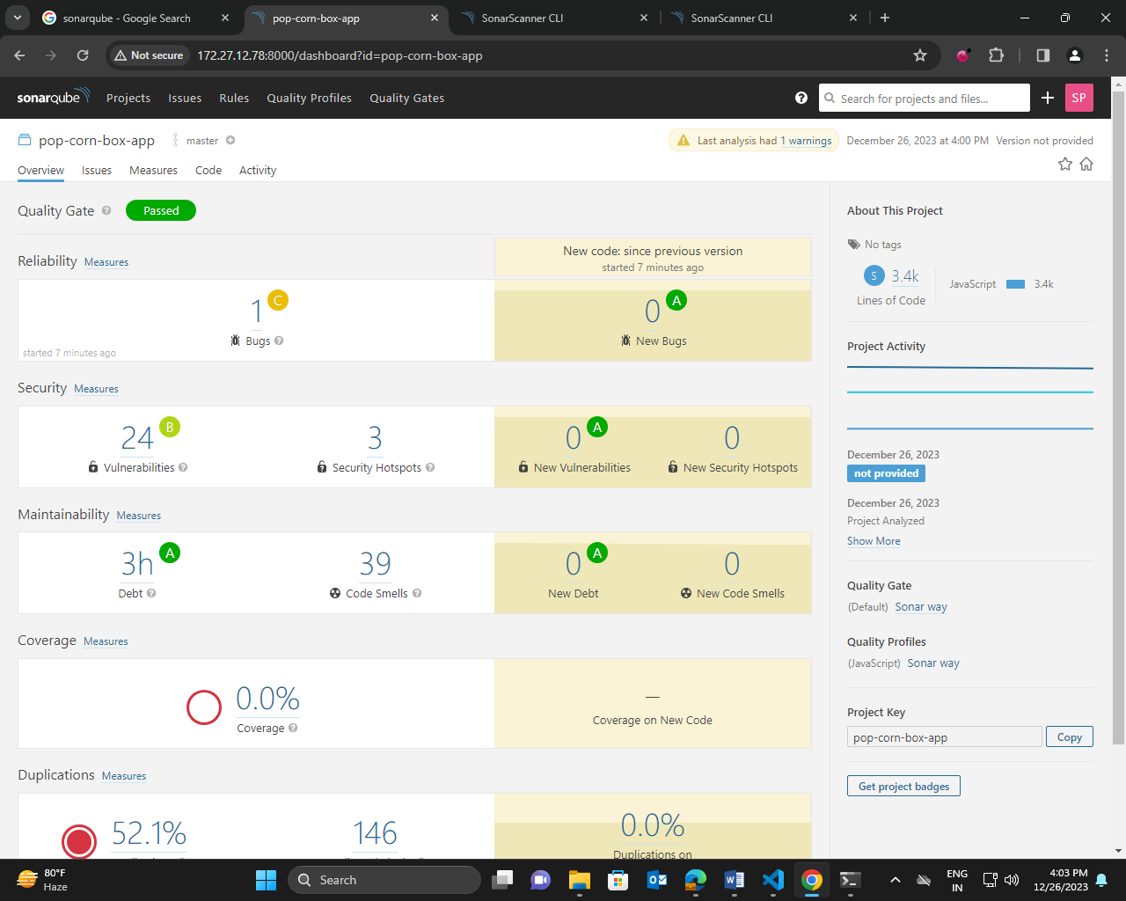
SonarQube report

Slide 9
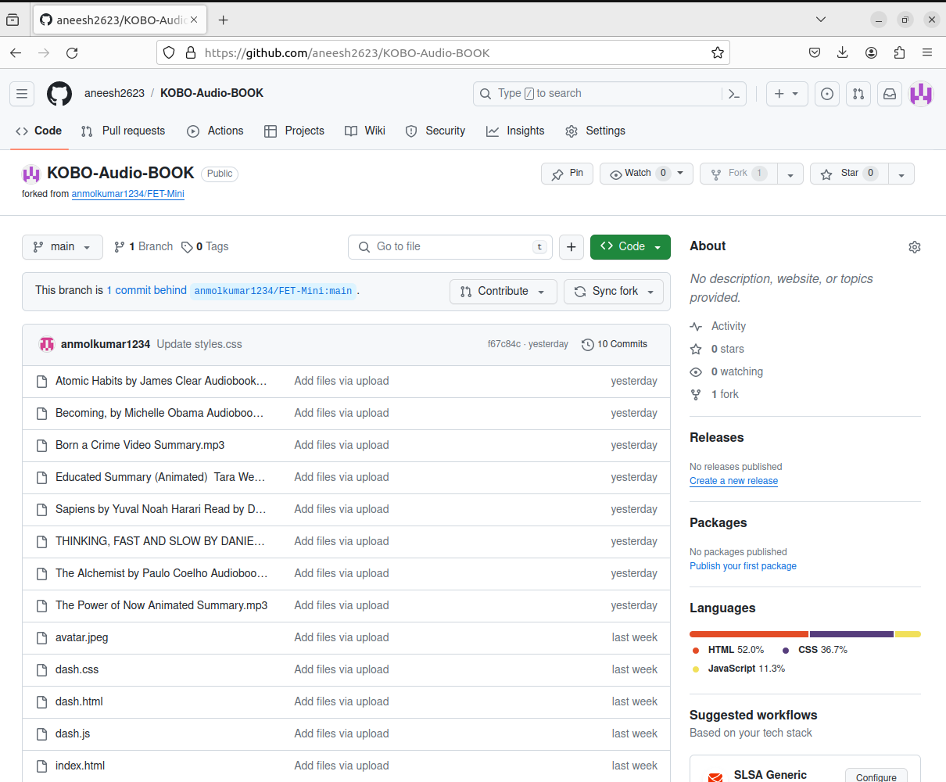
GitHub Implementation

Slide 10
THANK YOU

